Slide 1
Insurance Marketing Report
For an Auto Insurance company, predict the customer lifetime value (CLV). CLV is the total revenue the client will derive from their entire relationship with a customer. Because we don't know how long each customer relationship will be, we make a good estimate and state CLV as a periodic value — that is, we usually say “this customer's 12-month (or 24-month, etc) CLV is $x”.

Slide 2
Customer Life Time value is Depend on
Variables Name Dependency(In Percent)
Monthly Premium Auto 67.2
Number of Policies 35.1
Employment Status 8.2
Vehicle Class -6.4
Coverage 4.1

Slide 3
Summary Call: lm(formula = `Customer Lifetime Value` ~ ., data = train[-c(1, 2, 4, 6, 8, 9, 10, 11, 13, 14, 16, 17, 18, 19, 20, 22, 23, 24)]) Residuals: Min 1Q Median 3Q Max -0.6079 -0.2415 -0.1201 0.1584 1.0862 Coefficients: Estimate Std. Error t value Pr(>|t|) (Intercept) 5.353331 0.090901 58.892 < 2e-16 *** Coverage 0.041118 0.006726 6.113 1.03e-09 *** EmploymentStatus 0.082620 0.008563 9.648 < 2e-16 *** `Monthly Premium Auto` 0.672632 0.019819 33.939 < 2e-16 *** `Number of Policies` 0.351835 0.005284 66.581 < 2e-16 *** `Vehicle Class` -0.064015 0.007563 -8.464 < 2e-16 *** --- Signif. codes: 0 ‘***’ 0.001 ‘**’ 0.01 ‘*’ 0.05 ‘.’ 0.1 ‘ ’ 1 Residual standard error: 0.3193 on 7301 degrees of freedom Multiple R-squared: 0.4882, Adjusted R-squared: 0.4878 F-statistic: 1393 on 5 and 7301 DF, p-value: < 2.2e-16
All Variables are
Significant
P – Value < 0.05
MAPE – Value → 0.03

Slide 4
Assumption of Regression
1.)Auto-correlated
lag Autocorrelation D-W Statistic p-value
1 -0.004887575 2.009598 0.67
Alternative hypothesis: rho != 0
P –value should be > 0.05
2.) Multicollinearity
VIF
Coverage 1.420997
EmploymentStatus 1.000506
Monthly Premium Auto 1.604003
Number of Policies 1.000813
Vehicle Class 1.170987
VIF Should be < 2

Slide 5
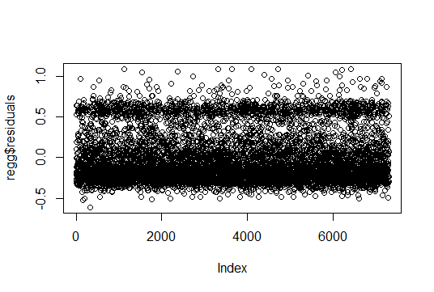
2.) Homoscedasticity
Residual plot should
be random

Slide 6
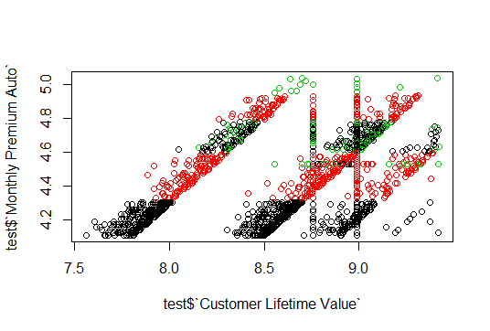
Monthly Premium Auto V/S CLV
BASIC
PREMIUM
EXTENDED
As Monthly Premium Auto increases,
Customer Lifetime Value is also increases

Slide 7
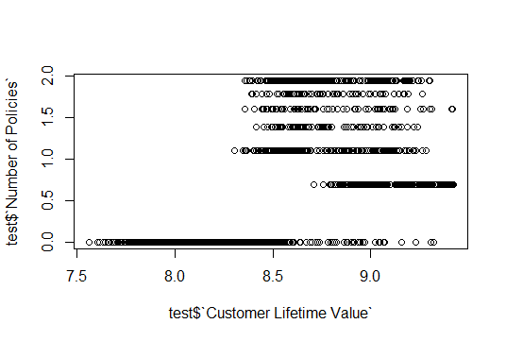
Number of Policies V/S CLV
As Number of Policies
increases,
Customer Lifetime Value
is increases

Slide 8
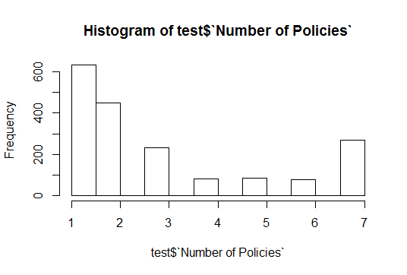
Number of Policies V/S CLV
Frequency of Number of Policies
First decreases then increases

Slide 9
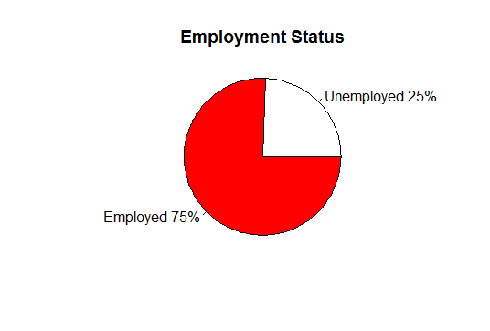
Employment Status V/S CLV
As Employment status
Customer Lifetime Value
is also increases

Slide 10
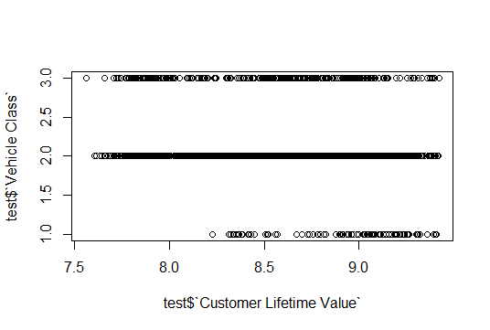
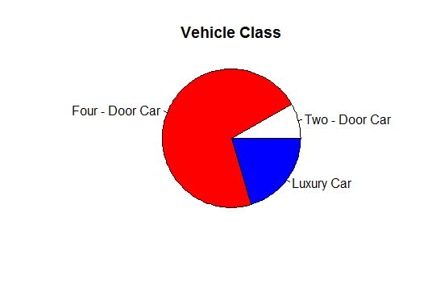
Vehicle class

Slide 11
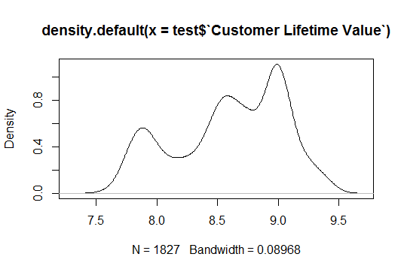
Customer Lifetime Value
Now we get
more profit
based on others

